Slide 1
RUNGTA COLLEGE OF DENTAL SCIENCES & RESEARCH ANTI-EPILEPTIC AGENTS Department of Pharmacology

Slide 3
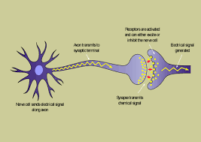

Slide 4
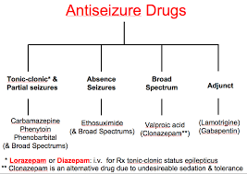

Slide 6
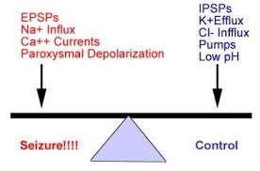

Slide 8
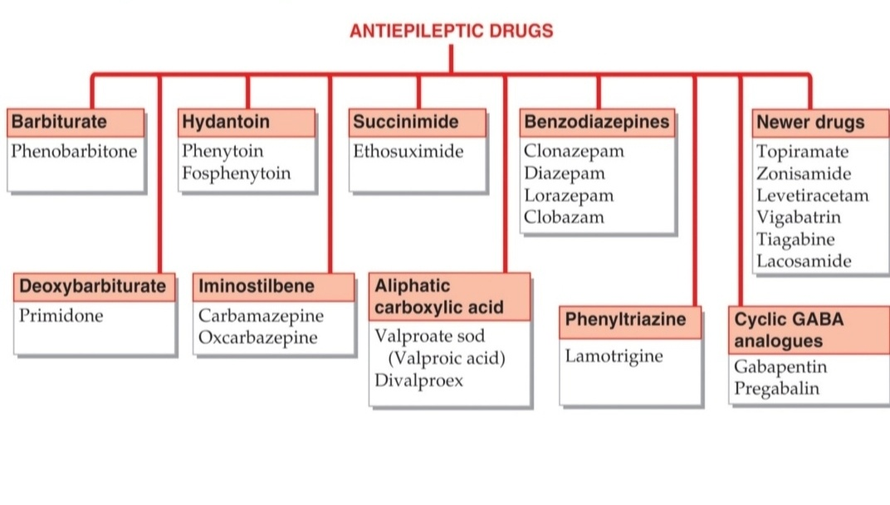

Slide 9
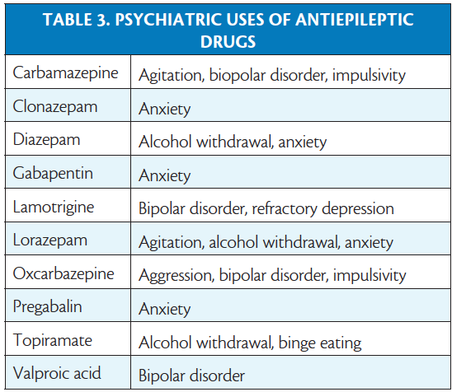

Slide 10
